Slide 1
CSE331: MICROPROCESSOR INTERFACING & EMBEDDED SYSTEMS
Lecture 2: Introduction to microprocessor #2
ARM processor
Credit: Dr. Mohammad A Qayum

Slide 2
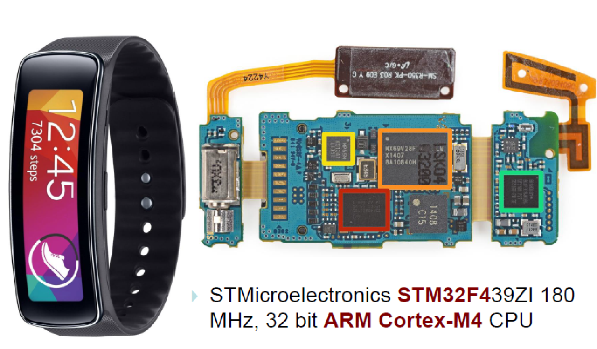
Samsung gear fitness tracker

Slide 3
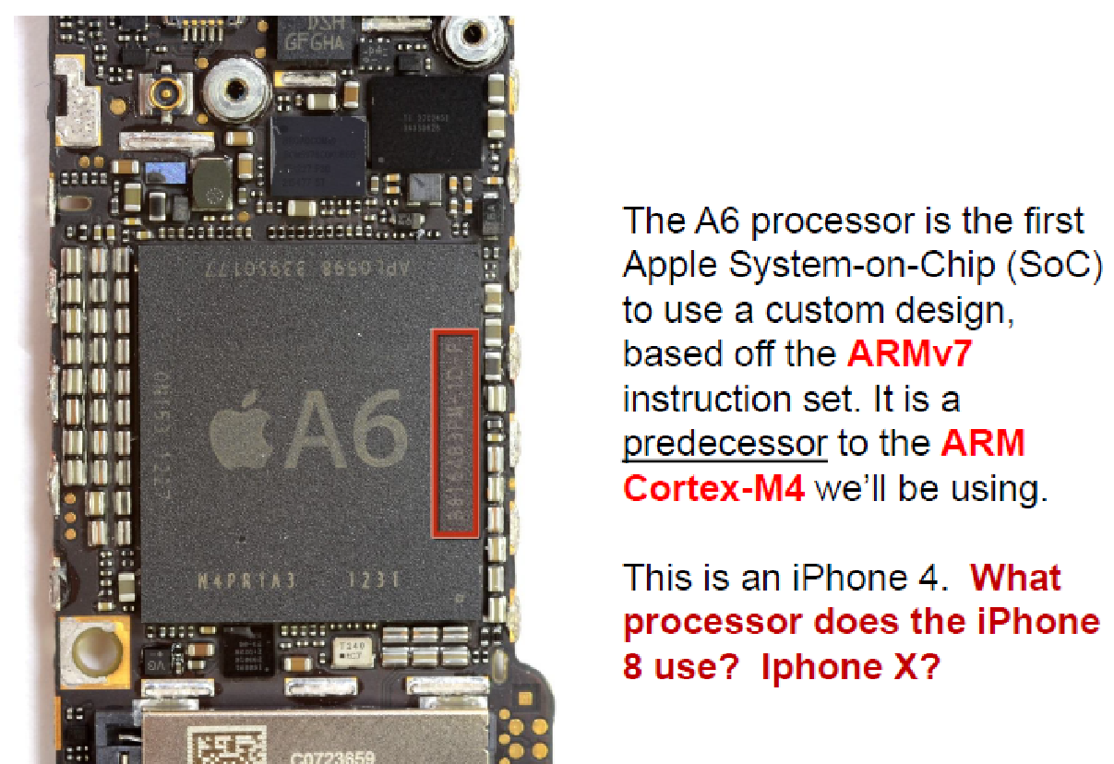
Iphone 4 breakdown

Slide 4
Features of ARM Cortex-M4 Microcontroller (STM32L475)
32-bit CPU (32 bit wide registers and address path)
856-915 MHz max internal clock
128 kBytes of on-chip RAM
1 MBytes of Flash memory
Sophisticated timer functions that include: input capture, pulse output, …
Communication interfaces: USART, SPI, I2C, CAN, …
A/D and D/A converters

Slide 5
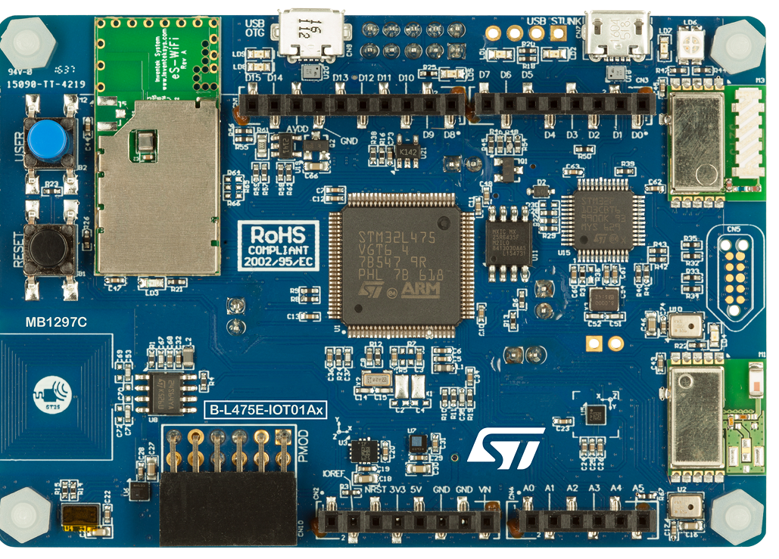
STM32L4 in a development board

Slide 6
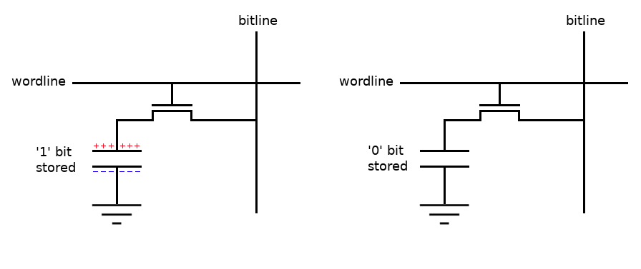
Let us recap some basics- Electronics
Analog circuits (R. L, C) and Digital Circuits (Transistor)
Flow of electrons is Current
HI or “1” logic is 5 volt that means large amount of electron will flow from measuring point to common point
LOW or “0” logic is 0 volt that means no amount of electron will flow from measuring point to common point
“1” logic stores enough electrons through capacitance effect using semiconducting technology that will create 5 volt potential

Slide 7
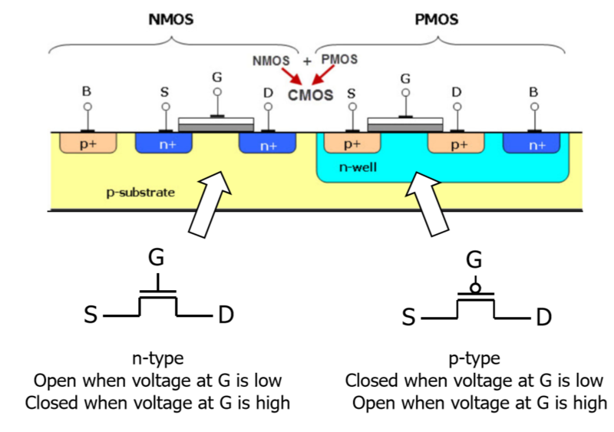
MOSFET: nMOS & pMOS

Slide 8
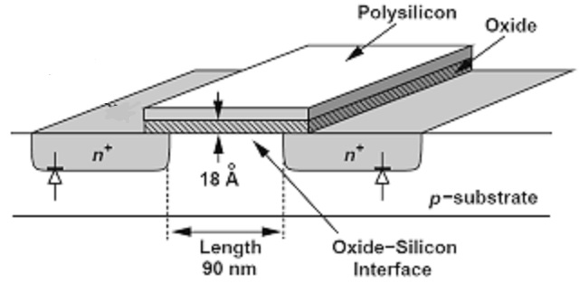
MOSFET: Channel Length (process technology node- 90nm)

Slide 9
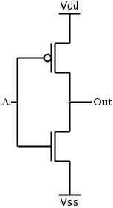
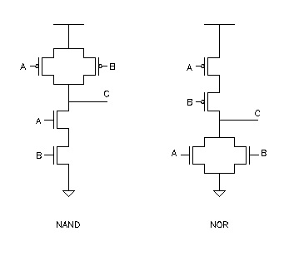
CMOS: not, nand, nor (universal gates)
NOT

Slide 10
Digital Circuit Classification:
Combinational Circuits
Output depends only solely on the current combination of circuit inputs
Same set of input will always produce the same outputs
Consists of basic gates such as AND, OR, NOR, NAND, and NOT gates

Slide 11
Sequential Circuits
Output depends on the current inputs and state of the circuit (or past sequence of inputs)
Memory elements such as flip-flops and
registers are required to store the “state”
Same set of input can produce completely different outputs

Slide 12
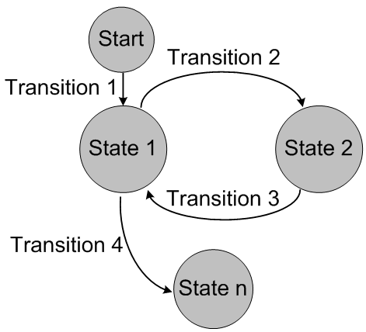
Sequential Circuit: State Machines

Slide 13
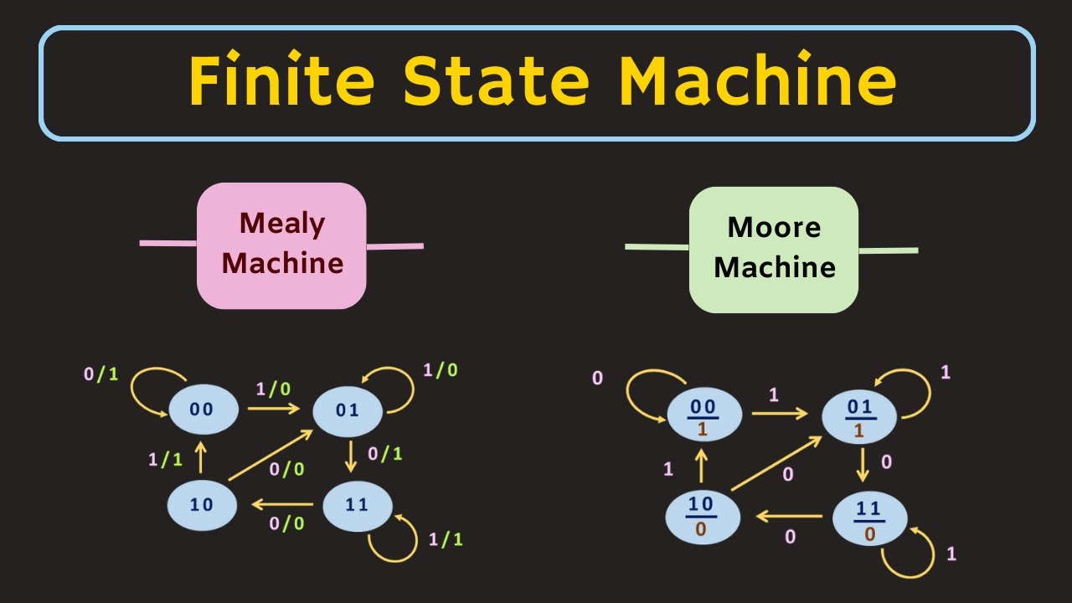
Mealy and Moore Machine

Slide 14
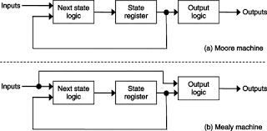
Mealy vs Moore Machine

Slide 15

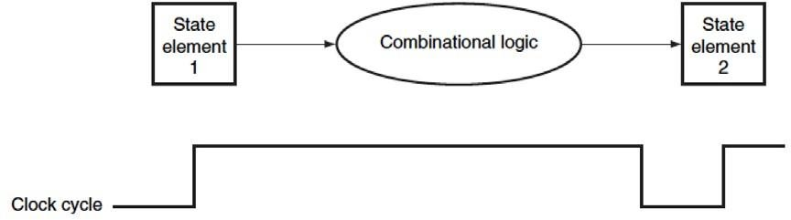

Clock and Change of State
Clock controls when the state of a memory element changes
Edge-triggered clocking: all state changes occur on a clock edge.
Register Transfer Level (RTL)

Slide 16
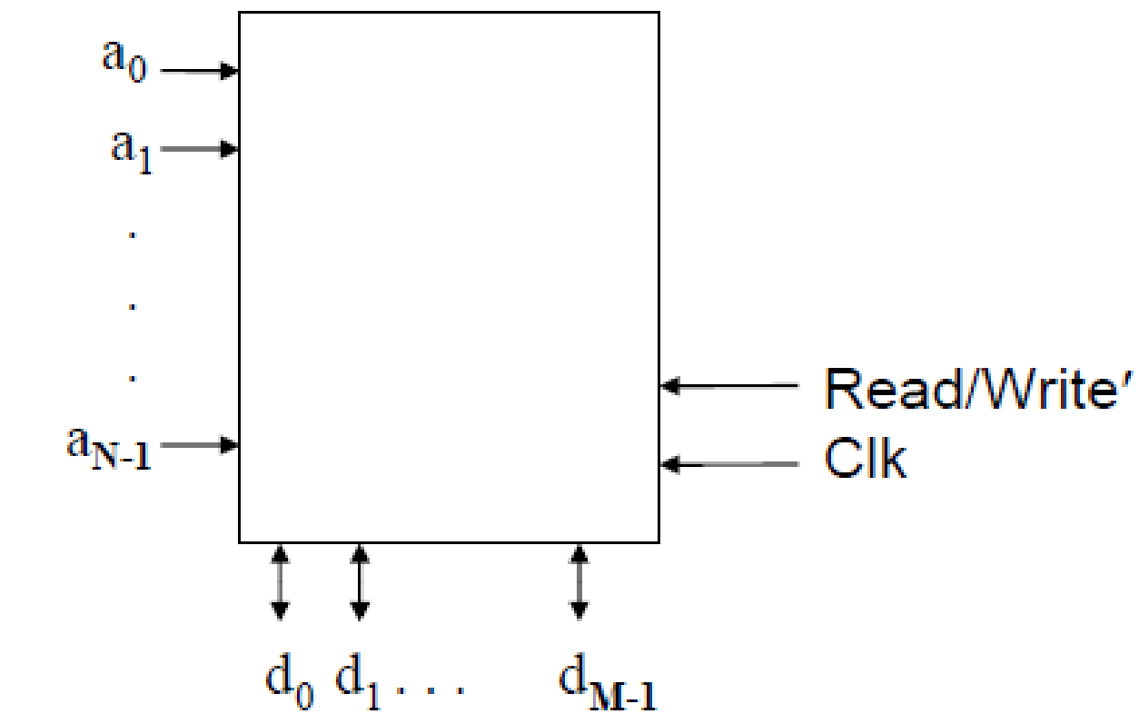
Memory
Another common subsystem in microprocessors is MEMORY, with multiple address lines and multiple data lines:
The above has N address lines and M data lines. The capacity of this memory system is ???

Slide 17
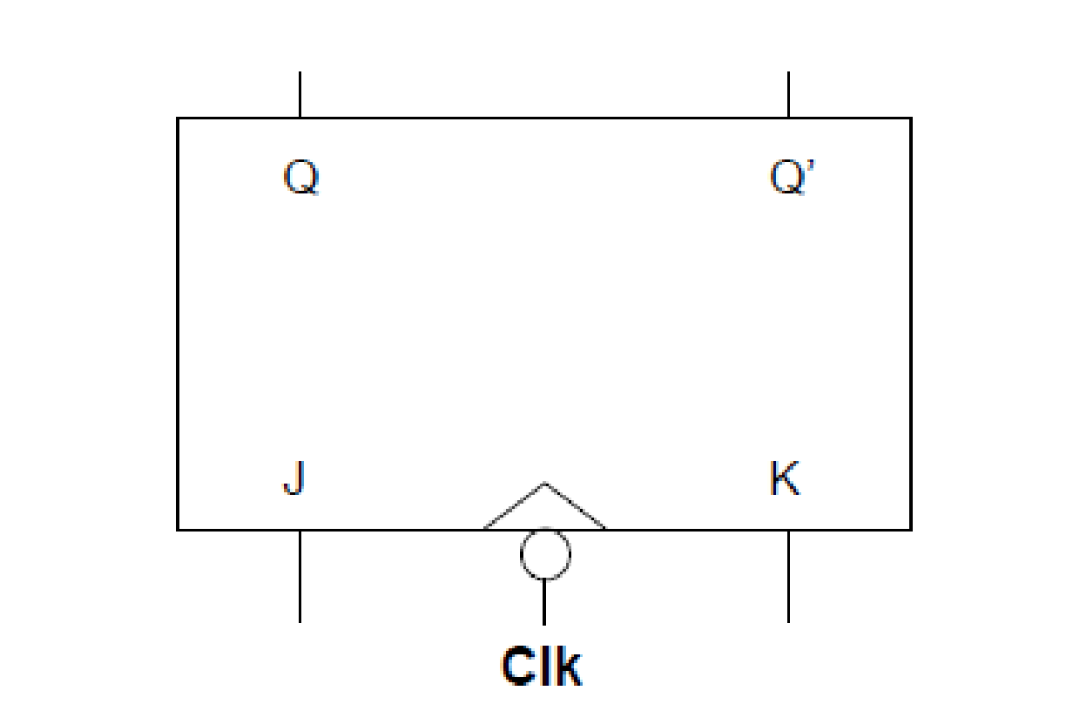
Flipflops- unit of memory
A key memory device in microprocessors is the flip-flop.
Remember: Flip-flops are clocked. Latches are not.
Computers use clocked circuits => flip-flops.
For example, a J-K flip-flop is shown as:
In microprocessors, flip-flops are typically grouped together with common control signals into registers.

Slide 18


Bit Storage Using SR Latch
Simplest memory elements are Latch and Flip-Flops
SR (set-reset) latch is an un-clocked latch
Output Q=1 when S=1, R=0 (set condition)
Output Q=0 when S=0, R=1 (reset condition)
Problem - Q is undefined if S=1 and R=1
Call but ton
S
Blue light
Cancel
but ton
Q
R

Slide 19
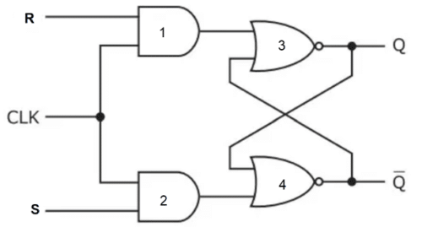
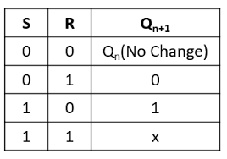
SR Flip-flop or simply Flip-flop

Slide 20
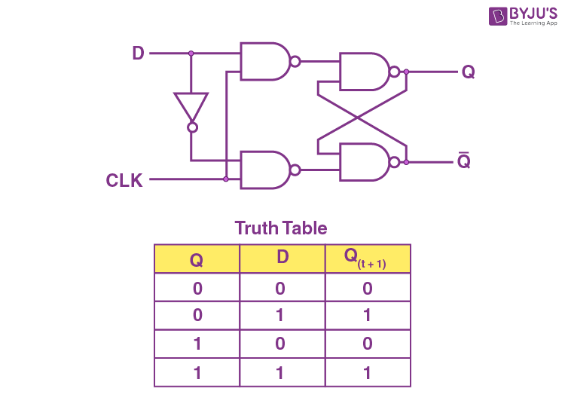
D Flip-flop

Slide 21
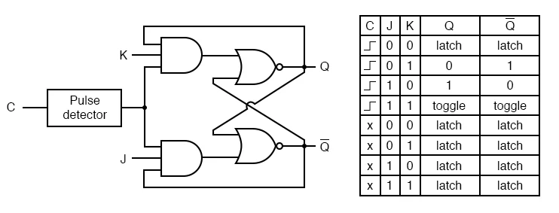
JK Flipflop

Slide 22
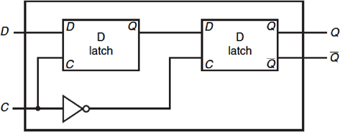
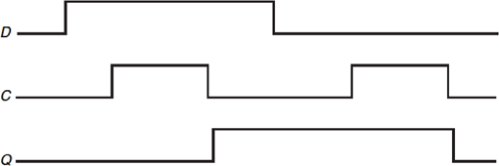
Clock Edge Triggered Bit Storage
Flip-flop - Bit storage that stores on clock edge, not level
Edge triggered D Flip-flop
Two latches, master and slave latches.
Output of the first goes to input of second, slave latch has
inverted clock signal (falling-edge trigger)

Slide 23

N-Bit Register
Cascade N number of D flip-flops to form a
N-bit register
An example of 8-bit register formed by 8 edge-triggered D flip-flops

Slide 24
Memory Types: ROM and RAM
Random Access Memory
Dynamic Random Access Memory (DRAM): periodic refresh is required to maintain the contents of a DRAM chip
Static Random Access Memory (SRAM): no periodic refresh is required. Always more predictable and usually faster than DRAM.
Read-Only Memory
Mask-programmed read-only memory (MROM): programmed when being manufactured
Programmable read-only memory (PROM): the memory chip can be programmed by the end user

Slide 25
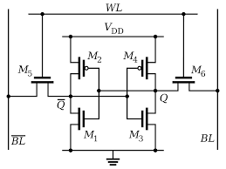
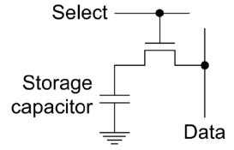
Memory: SRAM and DRAM
SRAM single cell
DRAM single cell

Slide 26
EPROM, EEPROM, FLASH
Erasable Programmable ROM (EPROM)
1. Electrically programmable many times
2. Erased by ultraviolet light (through a window)
3. Erasable in bulk (whole chip in one erasure operation)
Electrically Erasable Programmable ROM (EEPROM)
1. Electrically programmable many times
2. Electrically erasable many times
3. Can be erased one location, one row, or whole chip in one operation
Flash Memory
1. Electrically programmable many times
2. Electrically erasable many times
3. Can only be erased in bulk

Slide 27
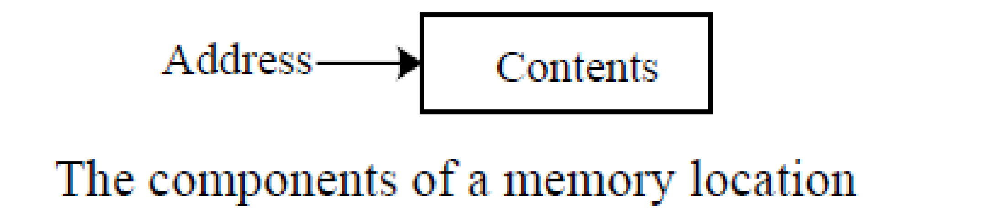
Memory Addressing
Memory Addressing
- Memory consists of a sequence of directly addressable locations.
- A location is referred to as an information unit.
- A memory location can be used to store data and instructions.
- A memory location has two components: an address and its contents

Slide 28
Architecture Basics
Computer Programs - Computer programs (programs) are known as software - A program is a sequence of machine instructions
Machine Instruction - A sequence of binary digits that can be executed by the processor - Hard to understand, program, and debug for human being - E.g. in the ARM Cortex M4,
instruction 0010 0010 0110 0100
How many bytes long is this instruction? Instruction is also 0x2264.
Assembly Language - Defined by machine instructions - An assembly instruction is a mnemonic representation of a machine instruction,
ADD R2 R1 R0 represents 0001100 010 001 000 = 0x1888 (hex format)

Slide 29
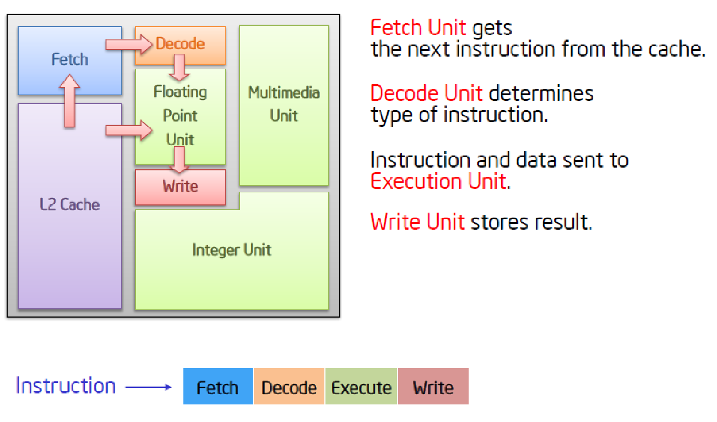
CPU stages

Slide 30
Architecture and Operations
Program counter: register PC “points to” (i.e. contains the address of) the memory location containing the next instruction to be executed.
Fetch: Using the current value of PC, read the next instruction to execute from memory. Store this data in the instruction register, IR.
Note that IR is an internal register, not accessible with computer instructions.

Slide 31
CPU stages (Pipelines)
Decode : Determine which instruction is to be executed using the contents of the IR.
Execute : Activate appropriate control lines in processor sequentially to perform the action specified by the Instruction at particular clock ticks.
Write: Write the output to the Data Memory

Slide 32
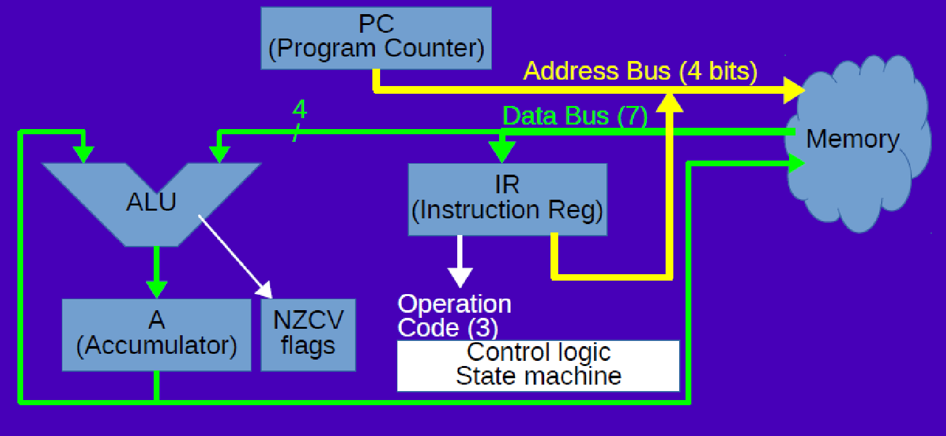
A SIMPLE CPU: PC, ALU, ACCUMULATOR, IR, MEMORY, BUSES, CONTROL LOGIC
4

Slide 33
INSTRUCTIONS AND PROGRAMMING
Instructions are the most basic actions the processor can process:
– ADD AX, BX # Add value AX to BX and store in AX
– CMP AX, 5 #Compare value in AX to 5
– JE 16 #Jump ahead 16 bytes if comparison was equal
Instruction Set Architecture (ISA) defines all the instructions of an architecture (e.g. ARM, X86)
High level programming languages (C, C++, Java) allow many processor instructions to be written simply:
– if (A + B = 5)
– then… #Jump if sum of A and B is 5
Every program (e.g. C) must be converted to the processor instructions (e.g. binaries) of the computer it will be run on

Slide 34
Target Addressing Example
Loop code from earlier example
Assume Loop at location 80000
Loop: | sll | $t1, | $s3, 2 | 80000 | 0 | 0 | 19 | 9 | 4 | 0
 | add | $t1, | $t1, $s6 | 80004 | 0 | 9 | 22 | 9 | 0 | 32
 | lw | $t0, | 0($t1) | 80008 | 35 | 9 | 8 | 0
 | bne | $t0, | $s5, Exit | 80012 | 5 | 8 | 21 | 2
 | addi | $s3, | $s3, 1 | 80016 | 8 | 19 | 19 | 1
 | j | Loop |  | 80020 | 2 | 20000
Exit: | … |  |  | 80024

Slide 35
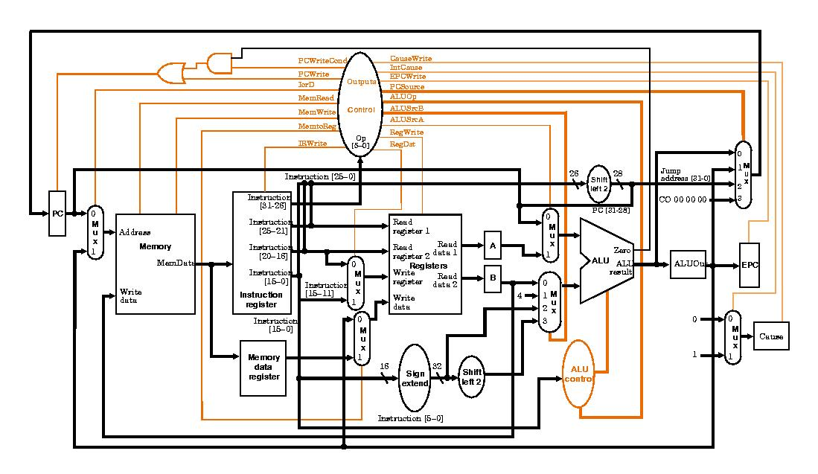
MIPS architecture

Slide 36
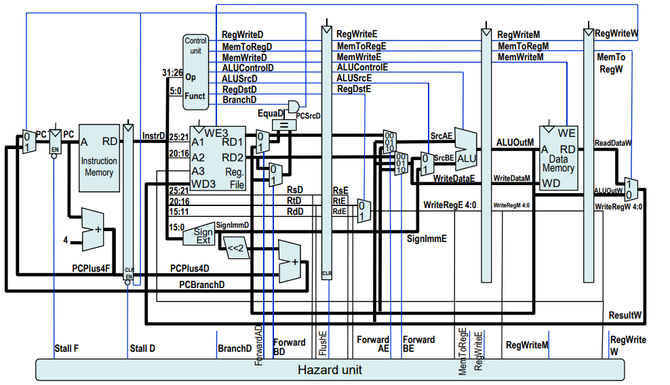
MIPS architecture with pipeline and hazard control

Slide 37
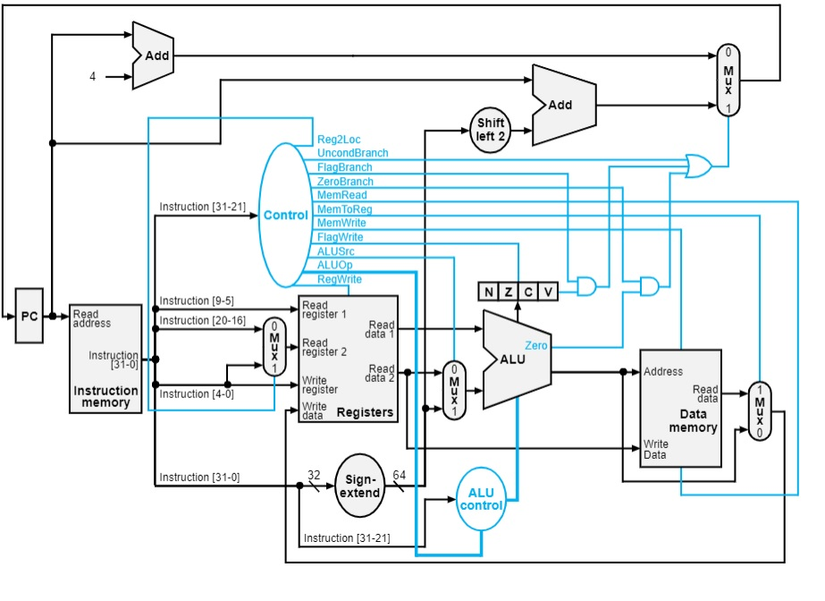
ARM architecture

Slide 38
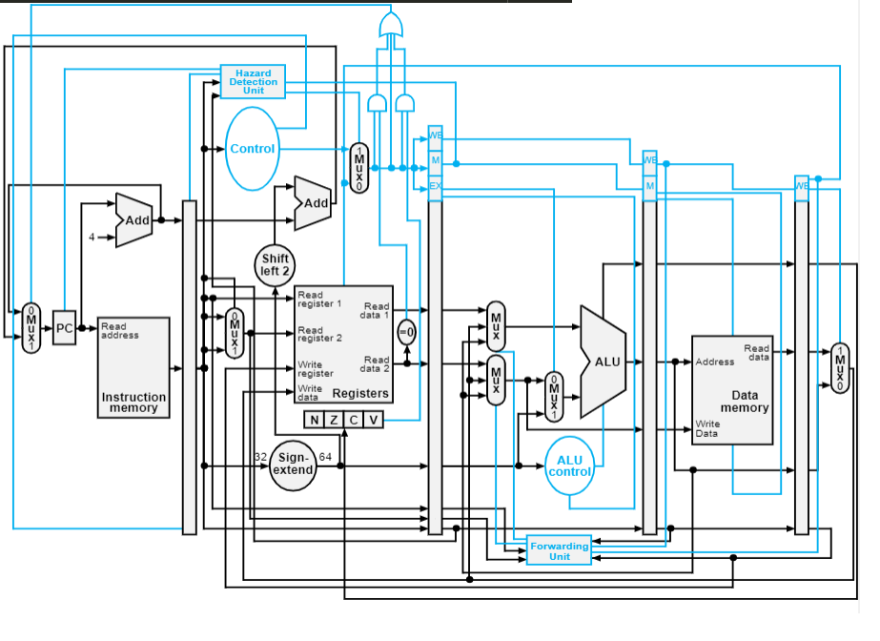
ARM architecture w Pipeline

Slide 39
A Instruction Stages Example
Let’s execute the instruction ADD R4,R3,R2
It is a 32 bit instruction located in Instruction Memory (I-cache)
This instruction means: add contents of register R2 to the contents of register R3, and store the results into register R4.
Here’s what happens: Fetch instruction, decode, and read from register addresses 0x00011 (R3) and 0x00010 (R2)
Connect register R2 to input 1 of the ALU and Connect register R3 to input 2 of the ALU.
Set controls to ALU to do a 32-bit add operation (Execute)
Store the output of the ALU into register R4 (i.e. connect R4 to output of ALU) (Write)
Increment the program counter and store that value back in the program counter: [PC]=[PC] + 4

Slide 40
MICROPROCESSOR ARCHITECTURE
Microprocessor (Computer) architecture is defined by the instructions (ISA) a processor can execute
• Programs (e.g. C) written for one processor can run on any other processor of the same architecture
Current architectures include:
– IA32 also known as x86
– IA64 also known as x86_64 (Intel, AMD)
– ARM (Qualcomm, Apple)
– PowerPC (IBM)
– MIPS
– RISC V (Open Source)
– Xtensa (ESP32)

Slide 41
Simulator
LEG8 Simulator: ARM University Education Program
https://github.com/arm-university/Graphical-Micro-Architecture-Simulator
Browser Based
Needs to be downloaded
CPUlator: University of Toronto
https://cpulator.01xz.net/doc/
Browser Based
No need to be downloaded

Slide 42
@.org 0x1000 // Start at memory location 1000
.data
numbers:
.word 1, 2, 3, 4, 5, 6, 7, 8, 9, 10, 11, 12, 13, 14, 15, 16, 17, 18, 19, 20, 21, 22, 23, 24, 25, 26, 27, 28, 29, 30
num_count:
.word 30
.text // Code section
.global _start
_start:
@ Initialize the sum to 0
mov r0, #0
@ Load the number of elements (30) into r1
ldr r1, =num_count
ldr r1, [r1]
@ Load the address of the numbers array into r2
ldr r2, =numbers
l

Slide 43
loop:
@ Load the current number into r3
ldr r3, [r2], #4 @ Load the value at the current address and increment the address by 4 bytes
@ Add the current number to the sum in r0
add r0, r0, r3
@ Decrement the counter (r1) by 1
subs r1, r1, #1
@ Check if the counter has reached 0 (end of loop)
bne loop @ Branch to 'loop' if r1 is not equal to 0
@ The loop is done; r0 contains the sum
@ Put your further code here or return from the function if needed
@ For example, to exit a program in ARM assembly, you can use the following:
mov r7, #0 @ syscall number for "exit"
// End program
_stop:
B _stop
.end

Slide 44
END OF LECTURE#2

